Slide 1


Data Bootcamp
Project 1
"Sustainable Energy and CO2 Emissions: Analyzing Global Trends and Impacts on Development"
Present:
Kevin Dorado
Katia Cuevas
Rodrigo Figueroa
Miguel Montemayor
Project 1: Data bootcamp

Slide 2







Sustainable development goals
introduction
Trends in Sustainable Energy Usage by Country
carbon dioxide (CO2) Emissions Comparison: BRICS and Mexico vs G7 Countries
The Agenda proposes 17 Goals with 169 targets of an integrated and indivisible nature that encompass the economic, social, and environmental spheres.
Global Energy Source Comparison: Nuclear, Renewable, and Fossil Fuels
Top 5 Countries in Sustainable Energy vs. Gross Domestic Product (GDP) Per Capita
World stadistics
Project 1: Data bootcamp

Slide 3
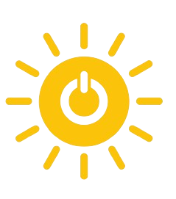
Affordable and clean energy
Sustainable development goals
Energy consumption remains the primary cause of climate change, accounting for around 60% of global greenhouse gas emissions.
The Agenda proposes 17 Goals with 169 targets of an integrated and indivisible nature that encompass the economic, social, and environmental spheres.
Project 1: Data bootcamp
Ensuring access to clean and affordable energy, for the development of agriculture, businesses, communications, education, healthcare, and transportation.

Slide 4
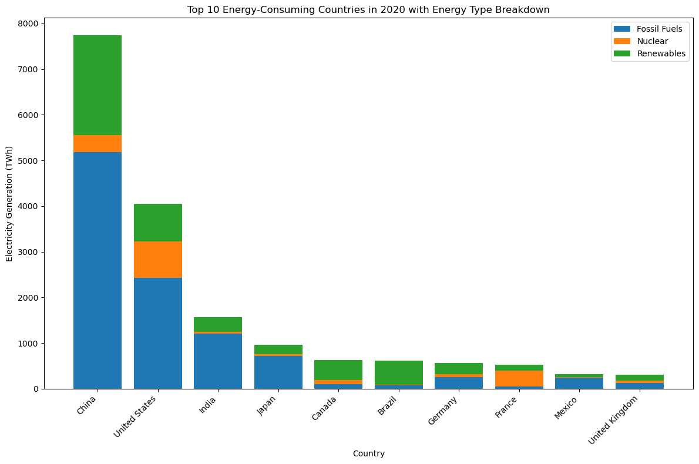
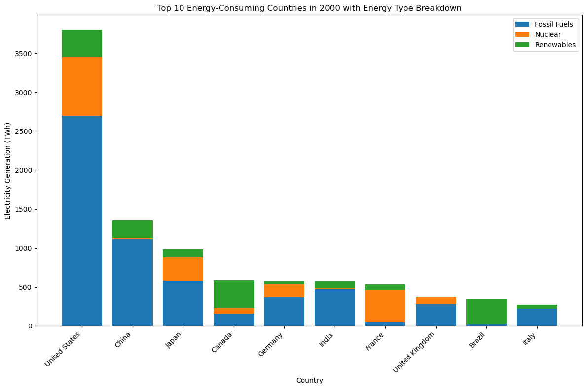
Affordable and clean energy
Energy consumption remains the primary cause of climate change, accounting for around 60% of global greenhouse gas emissions.
Ensuring access to clean and affordable energy, for the development of agriculture, businesses, communications, education, healthcare, and transportation.
Project 1: Data bootcamp

Slide 5
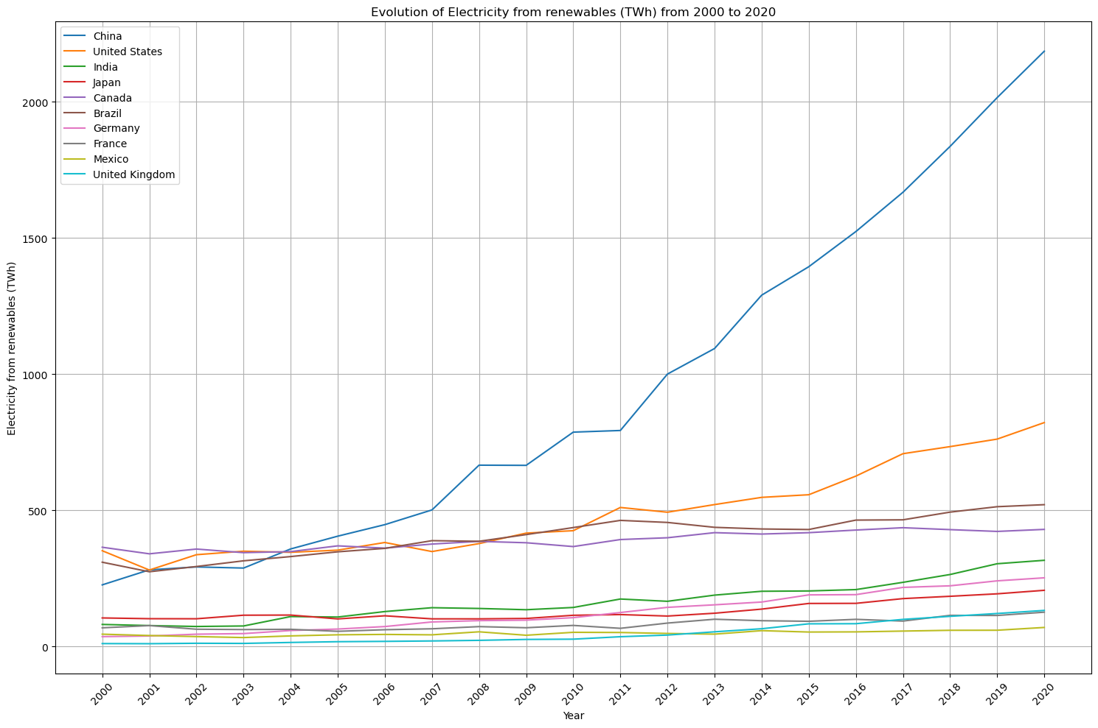
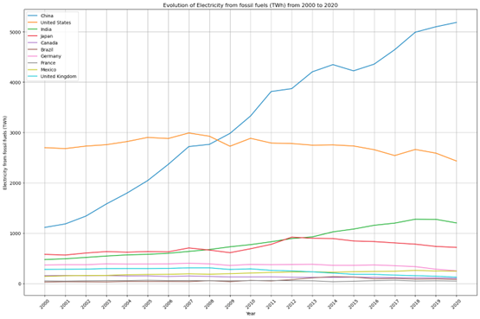
Top 10 energy-consuming countries in 2000-2020 with energy type breakdown
2000
2020

Slide 6
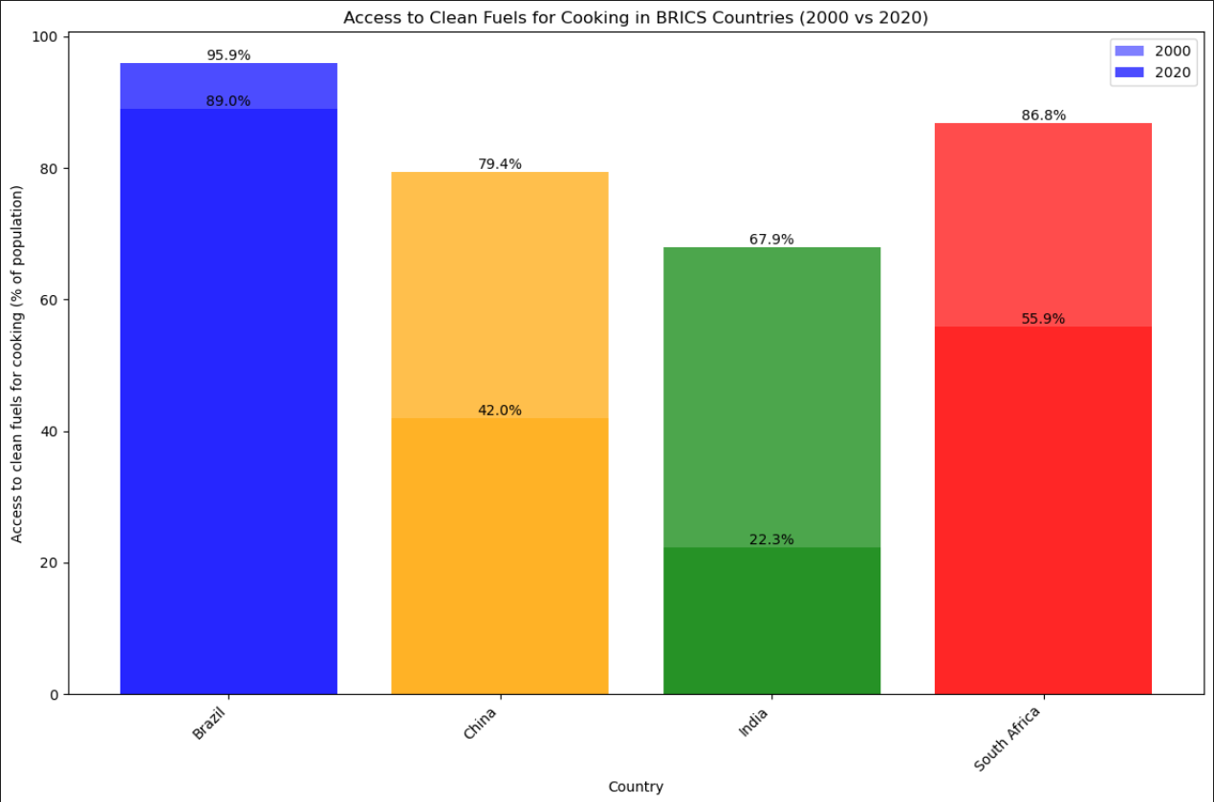
Evolution of Electricity from fossil fuels and renewables

Slide 7
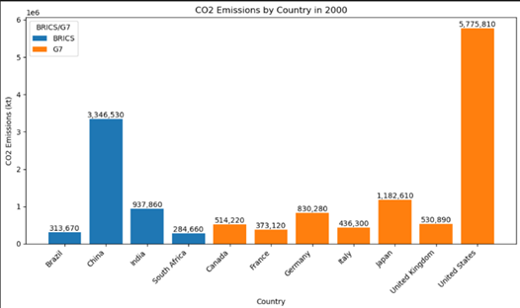
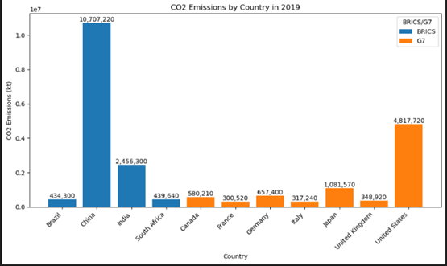
Access to clean fuels for cooking in brics countries (2000 vs 2020)

Slide 8
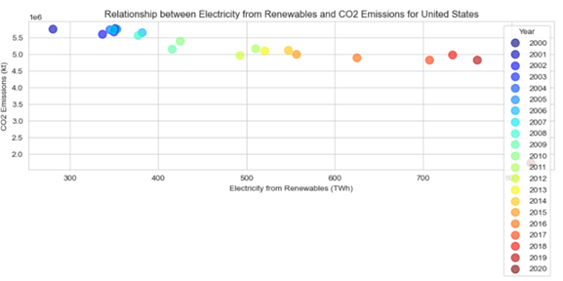
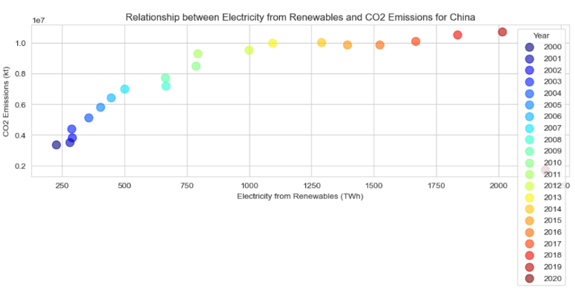
Co2 emissions by country
20o0
2019

Slide 9
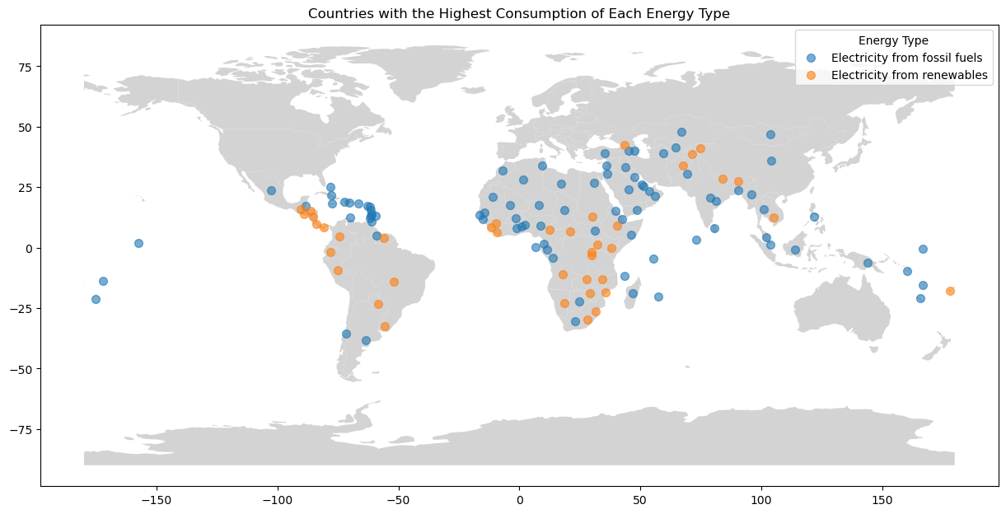
Relationship between electricity from renewables and co2 emissions for united states

Slide 10
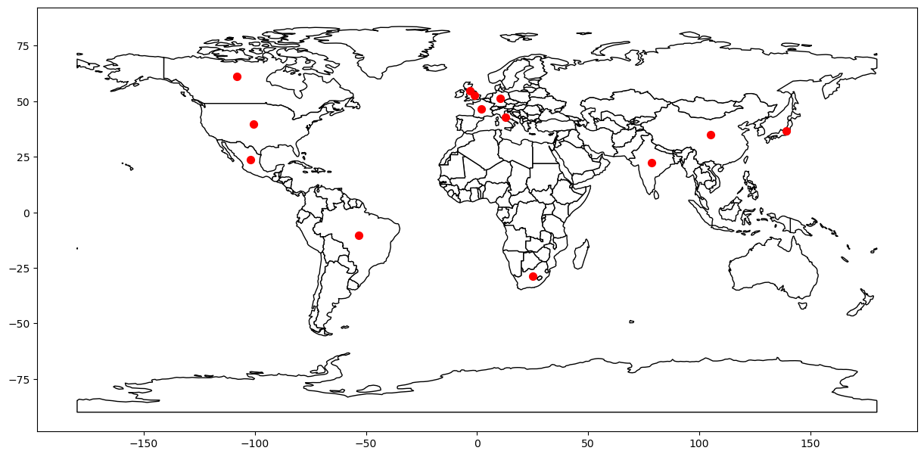
Countries with the highest consumption of each energy type

Slide 11
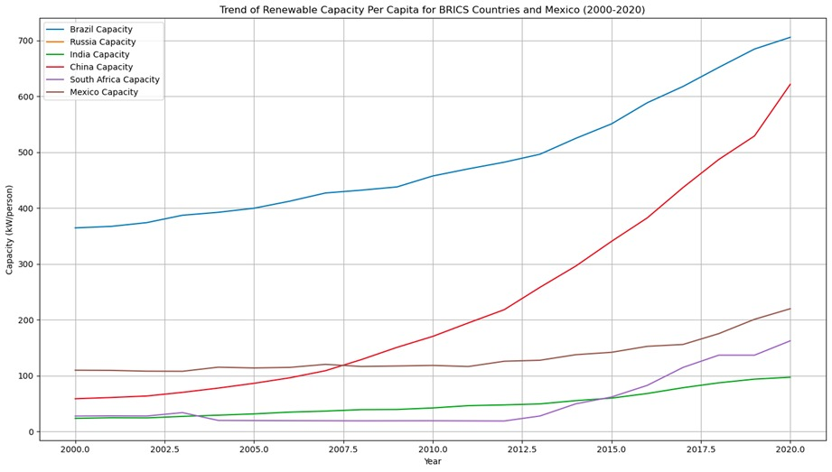
Countries from BRICS, G7 and Mexico

Slide 12
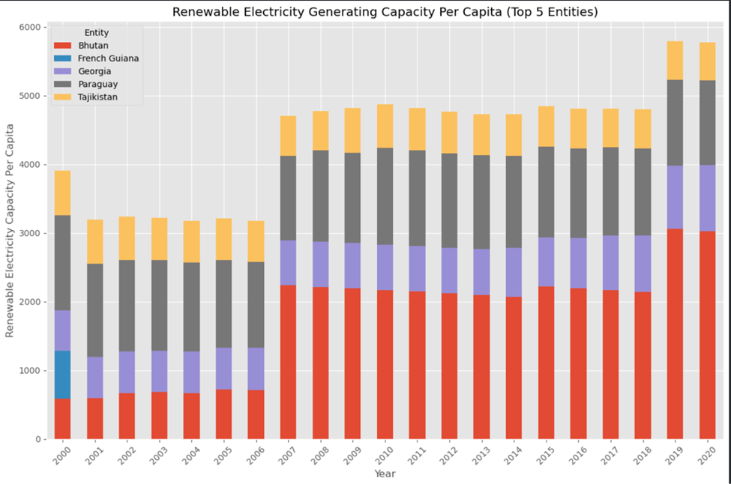
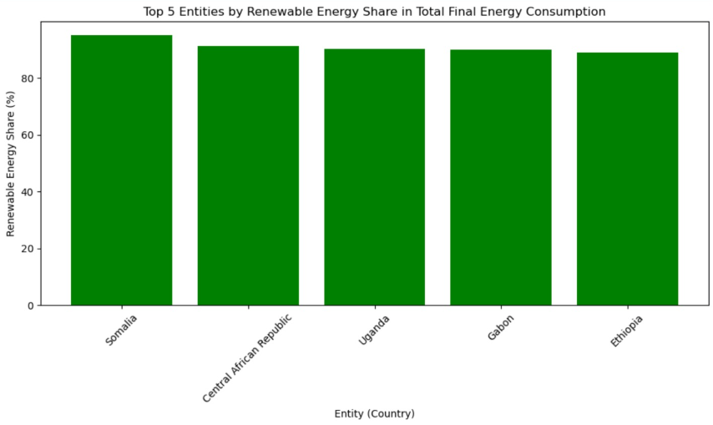
Top 5 entities by renawable energy share in total final energy consumption

Slide 13
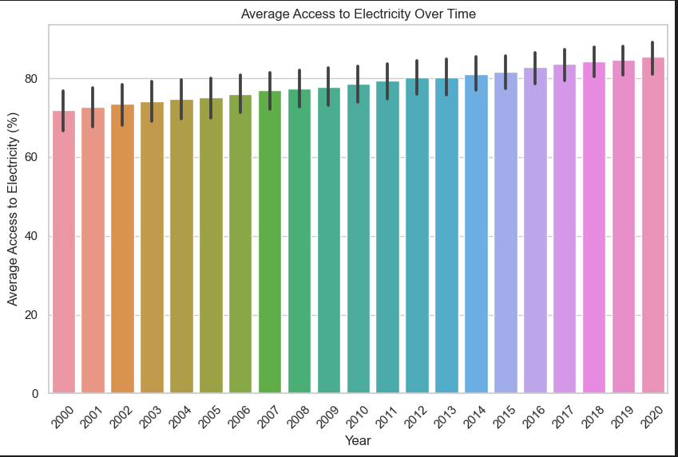
Renewable electricity generating capacity per capita (top 5 entities)

Slide 14
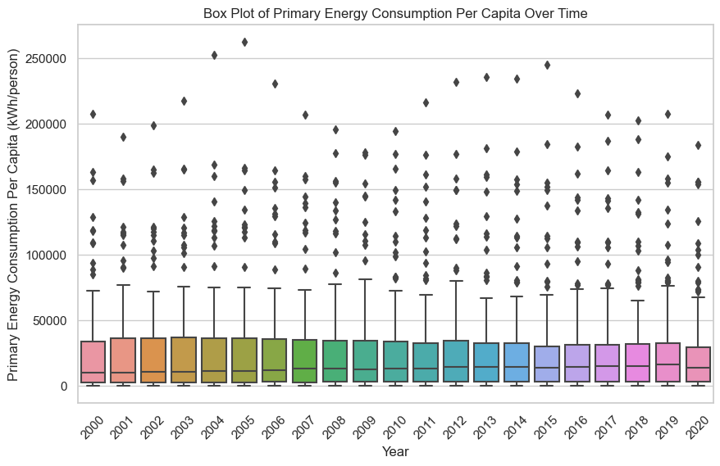
Average access to electricity over time

Slide 15
Box plot of primary energy consumption per capita over time

Slide 16
Conclusion
This presentation has highlighted the critical importance of moving towards sustainable energy to achieve the Sustainable Development Goals.
Energy consumption, as the major contributor to greenhouse gas emissions, demands urgent action.
Adopting renewable energies not only benefits the environment but also drives economic and social development. It is imperative that all sectors collaborate to implement clean technologies and improve energy efficiency.
Together, we can achieve a more sustainable and equitable future for the coming generations.

Slide 17
Bibliography
TANWAR, A. (2023, 11). Global Data on Sustainable Energy (2000-2020). From Kaggle: https://www.kaggle.com/datasets/anshtanwar/global-data-on-sustainable-energy/data
United Nations. (n.d.). From THE 17 GOALS: https://sdgs.un.org/goals
ONU
https//www.un.org/es/

